Slide 1
Repeatability and Reliability

Slide 2

By the end of this lesson you should be able to:
Describe what it means for an experiment to be repeatable and reliable.
Determine if an experiment is repeatable and reliable.
Discuss the importance of an experiment being repeatable and reliable.

Slide 3

To check the results were not a fluke or once off, the experiment should be repeated by the same people, using the same equipment in the same environment.
This method is used to check an experiment's reliability.

Slide 4
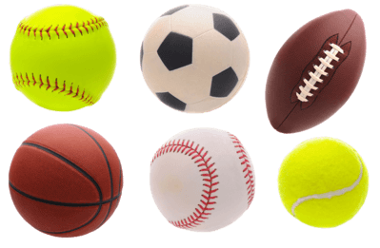
For an experiment to be reliable, similar results must be produced more than once by the same experimenter, on the same equipment, under the same conditions.
For example, you might want to know whether a soccer ball, a football, or a basketball bounces the highest after being dropped from 1 metre. You could drop each ball next to a 1 metre ruler and have a person measuring the height of the bounce.

Slide 5

After 1 trial of each ball (1 bounce), you found that the basketball bounced the highest.
However, this is not a reliable result. The experiment has not been repeated.
The height of the bounce could have been a one off.
An experiment should be repeated at least 3 times or until you get 3 similar results in a row.

Slide 6
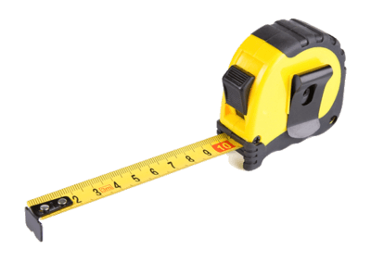
After 6 trials of each ball, you found that the basketball bounced the highest every time.
You could now conclude that the experiment produced reliable results.
For this experiment to be reliable, you would have to have used the same balls, measuring tape, measurer and ball dropper the whole time.

Slide 7

It is always possible that the results produced on certain equipment, and by certain people might be somehow different to those produced in other contexts.
To make sure the results are not unique to the people, equipment and environment, an experiment must be able to be repeated in different contexts, under different conditions and still produce the same results.

Slide 8


This is known as the repeatability of an experiment and its results.
For results to be repeatable, an experiment must produce similar results when done by different people on different equipment in a different environment.

Slide 9

If an experiment does not produce similar results in different contexts, then the results are not suitable to answer your experimental question.
Therefore, they could not be used to draw conclusions from.

Slide 10

Repeatability and reliability can both be used to test whether an experiment is providing a good measure of the variables it is meant to examine.

